Slide 1
The US Army’s Physical Fitness Test (APFT) in Infantry Basic Training
An exploration on why there is a high initial high failure rate and what can be done to lower the failure rate
By Thompson C. Liu

Slide 2
Thesis
Can we predict pass or fail by only looking at specific exercises within the APFT?

Slide 3
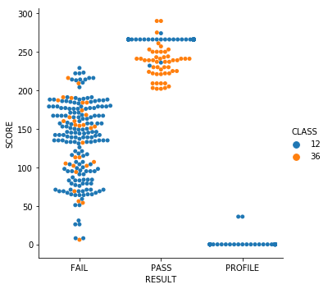
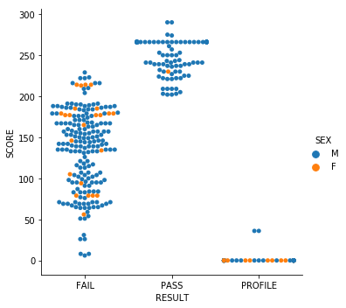
Current Initial APFT Score

Slide 4
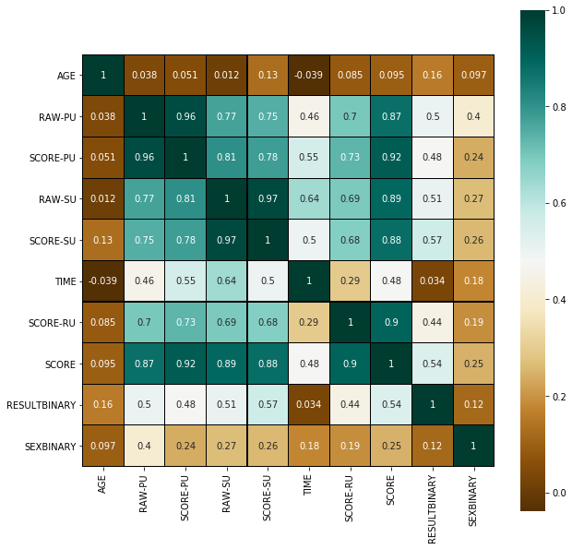

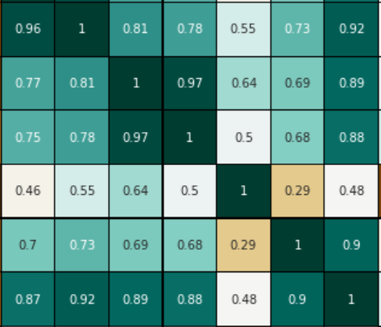

What are the Important Factors in the APFT?

Slide 5
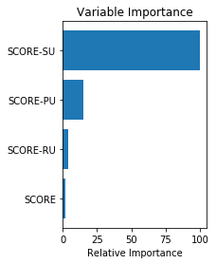
Significant Variables and Estimated Coefficients
Param: C=1
Coefficients Train
[[-0.00295489 -0.0032741 0.08611231 0.01310302]]
[-4.62028832]
Coefficients Test
[[ 0.05237088 -0.02383646 0.03673225 -0.03723642]]
[-7.89356387]
Accuracy of PASS status
RESULTBINARY 0 1
row_0
0 62 0
1 5 69
Percentage accuracy
0.9446494464944649
Percentage accuracy
0.9632352941176471
CV
array([0.92857143, 1. , 0.88888889, 0.88888889, 0.96153846])

Slide 6
Models which were not optimal
Linear Regression
Dependent variable is categorical
Lack of Linear Relationship
Decision Tree
High R^2: .988
Random Forest
Did not reduce R^2
High R^2: .963

Slide 7
Limitations
Lack of data for costs of Soldiers who are on profile
The dependent variable was converted to binary
Not enough female Soldiers to accurately make a determination
Due to the class imbalance between Pass and Fail(to include Profile) down sampling was utilized.
Down sampling gender would not have been accurate due to the lack in size of the female populations

Slide 8
Recommendations
Failures of the initial APFT should be put into a separate Basic Training Company.
Failures should work more on their Sit-ups to prevent injury as well as improve their overall score.

